Slide 1
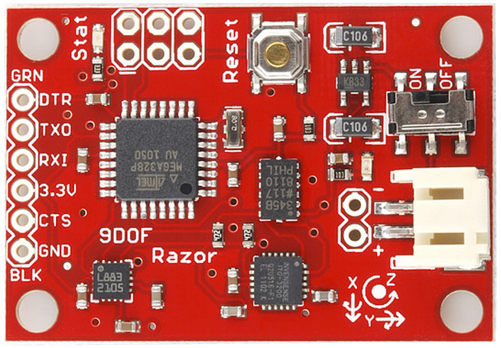
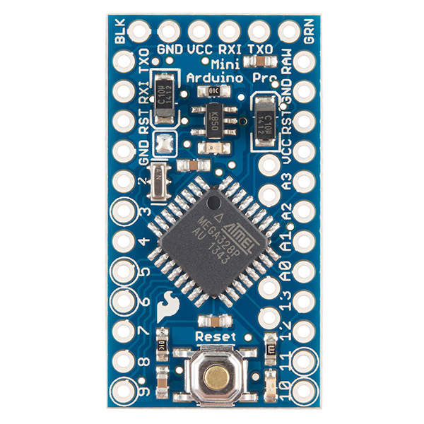
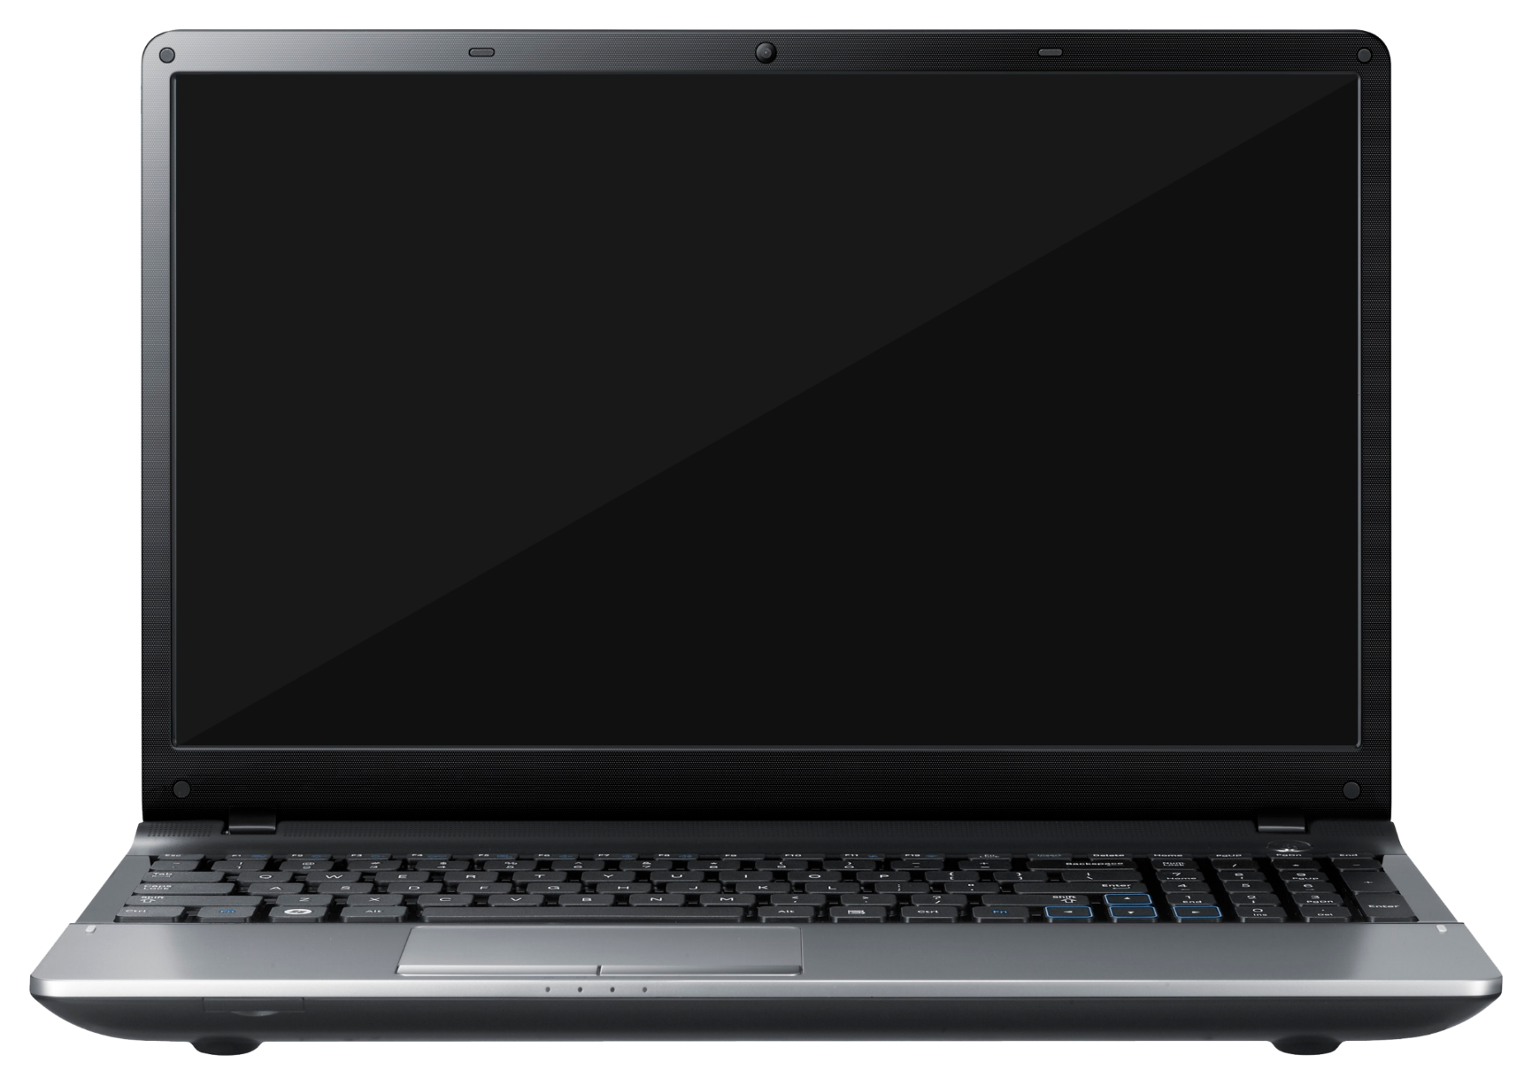
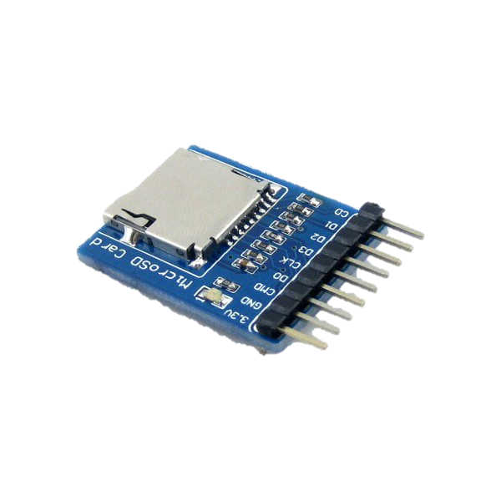
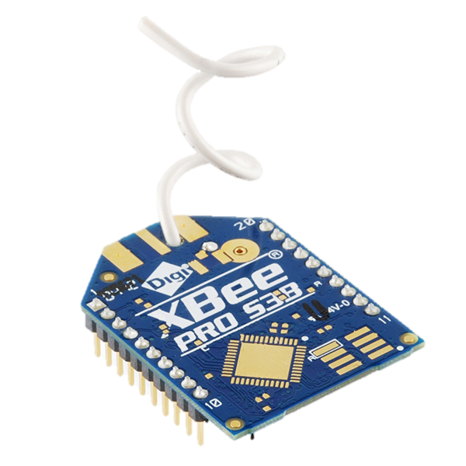

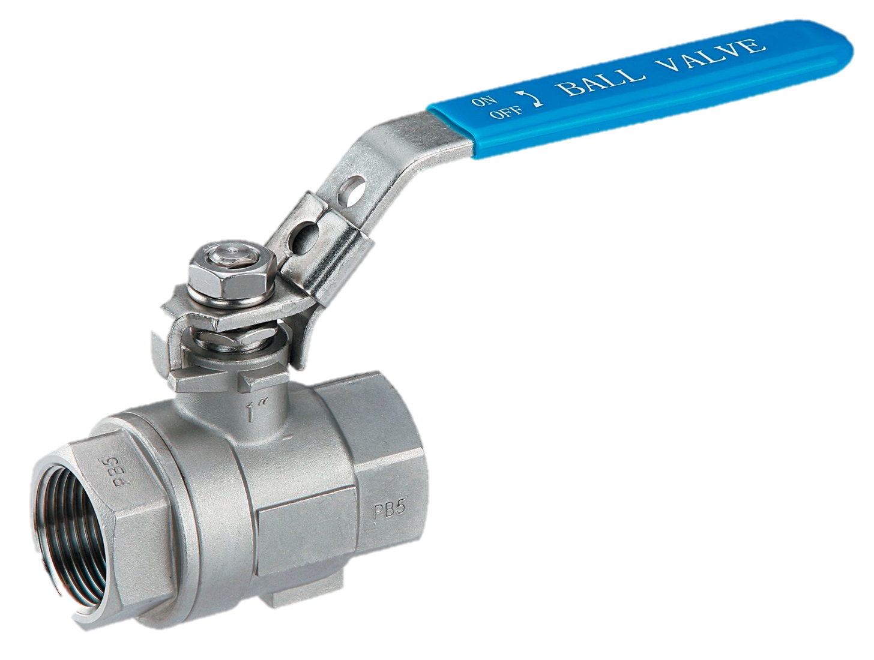
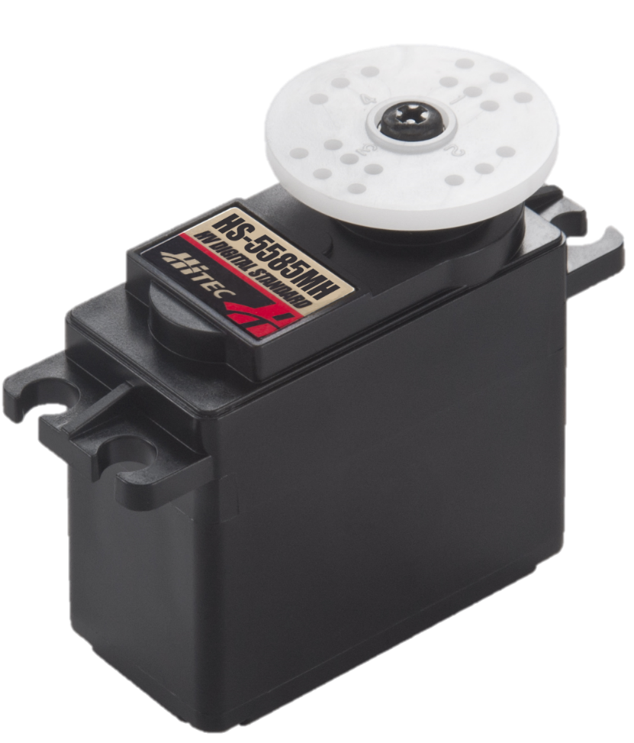
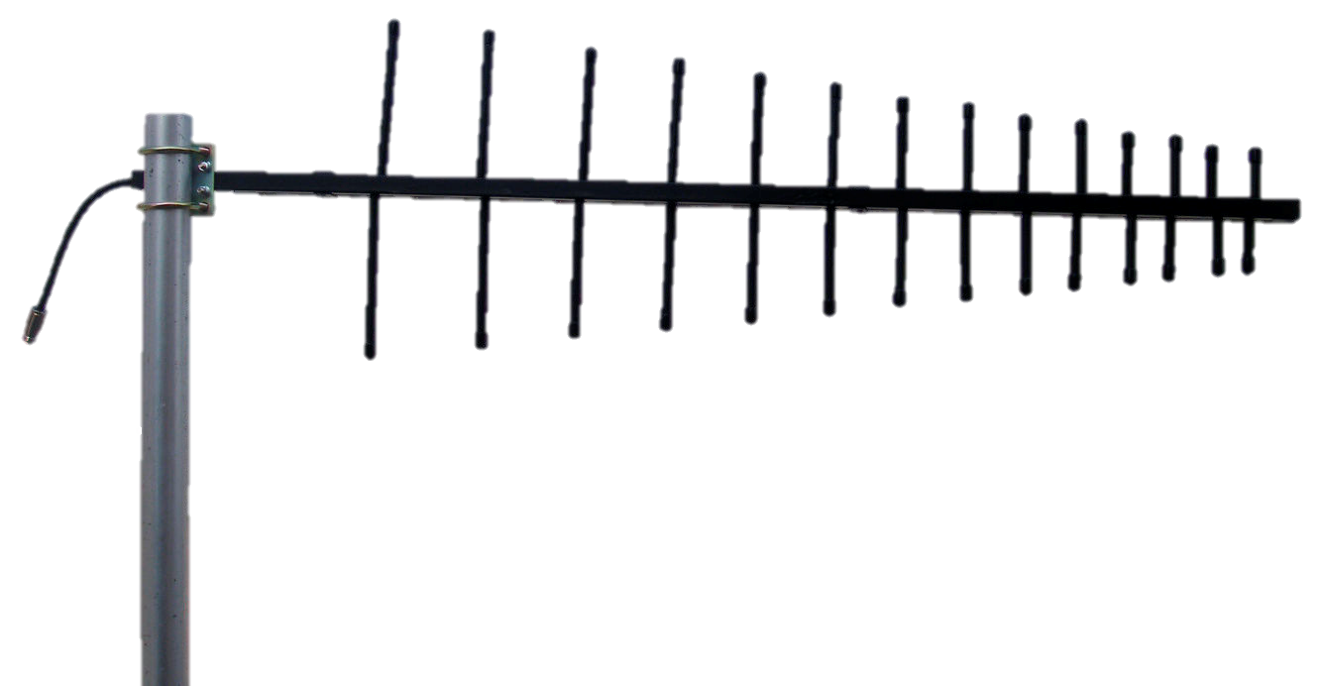
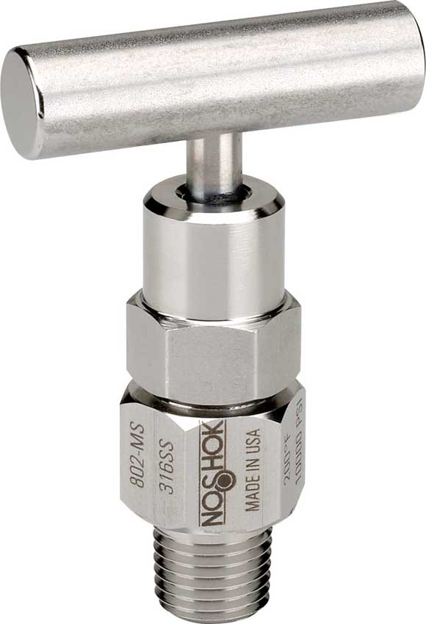
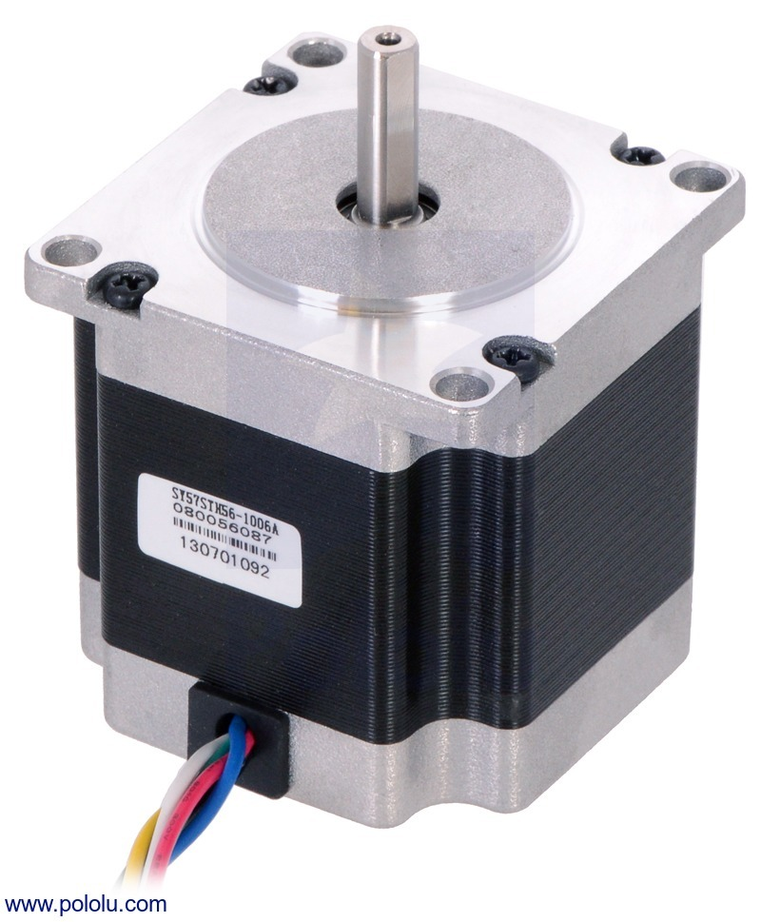
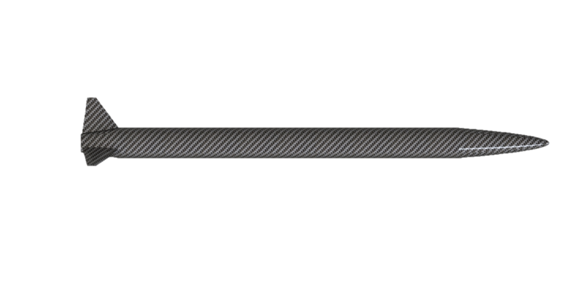
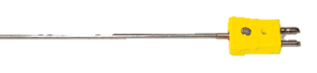
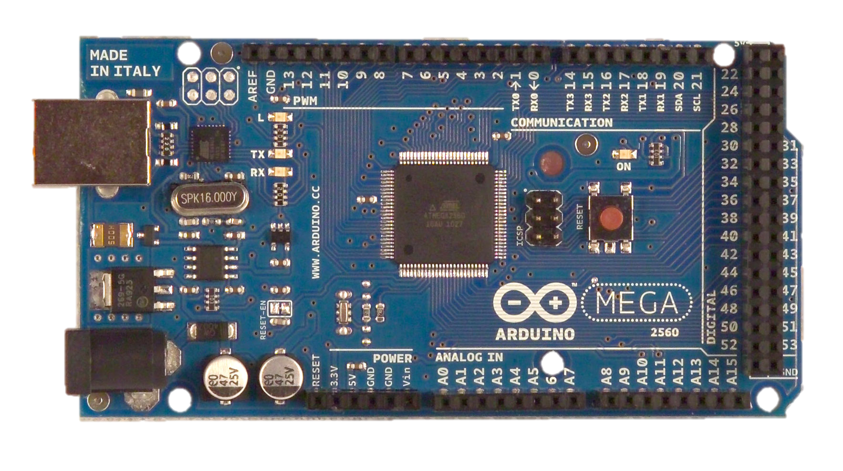
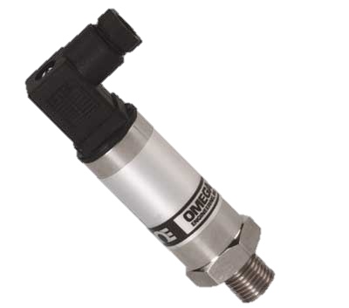

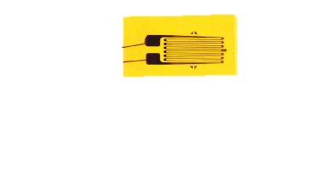
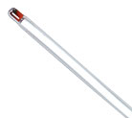
Pins: TX/RX, 5V, GND
Pins: 5V, GND, 11, 12, 13, SS
1
Pins: 12V, GND, A2
Pins: 5V, GND, 6, 7, 8, 9
2
Pins: TX/RX
: Wireless
: Wired
: Vehicle
: Launch Box
: Ground Ctrl
Pins: 12V, GND, 5V, GND, EN, RESET, SLEEP
Pins: 5V, GND, 12, 13, SS
Pins: 12V, GND, A3
3
Pins: 5V, GND, TX/RX
Pins: 5V, GND, 11, 12, 13, SS

Slide 2
References
http://flipmu.com/files/2011/12/ArduinoMega2650Front_21.jpg
https://cdn.sparkfun.com//assets/parts/7/6/9/4/11634-01.jpg
http://png-images.ru/wp-content/uploads/2015/02/02/4101/png/laptop_PNG5900.png
http://www.bhphotovideo.com/images/images1000x1000/Pelican_BB0050_0000_110_Hardigg_BB0050_BlackBox_5U_732914.jpg
http://www.clipartsfree.net/vector/large/21745-spark-plug-vector.png
http://www.uctronics.com/media/catalog/product/cache/1/image/9df78eab33525d08d6e5fb8d27136e95/a/r/arduino_mini_2mp_1.jpg
http://www.apexinst.com/uploads/prod/images/e085cf372577fab5120f3de0a0a90b9655a82524.jpg
http://www.robotshop.com/media/files/images/9-degrees-of-freedom-razor-imu-ahrs-compatible-large.jpg
http://www.omega.com/literature/transactions/volume3/images/strainpic1.jpg
http://www.liquidware.com/system/0000/3450/Pressure_Sensor_Top.jpg
http://www.robotshop.com/media/files/images/hitec-hs-5585mh-servo-motor-large.jpg
http://www.icra2013.org/wp-content/uploads/2012/11/09_MW_logo_CMYK1.jpg
http://innovo-lb.com/openkits/wp-content/uploads/2015/06/11113-02.jpg
http://www.inbuildingprojects.com/wp-content/uploads/2009/06/yagi.jpg
http://www.arduiner.com/1546-thickbox_default/microsd-card-breakout-board.jpg
http://www.omega.co.uk/pressure/images/PXM4102_l.jpg
http://m.c.lnkd.licdn.com/mpr/mpr/AAEAAQAAAAAAAAYeAAAAJGEyMGFlMjIzLTY3NTYtNDAwZC1iMDEwLTQ4ODM3YjY3YWY2Yw.jpg
http://www.noshok.com/images/needle_valves/800-series/800-series-large.jpg
http://www.omega.com/Temperature/images/OL-704_l.jpg
http://www.robotroom.com/Launch-Controller/Estes-model-rocket-igniter-before-and-after-launching.png
http://easypyro.com/image/cache/data/igniter/jtec_igniter_2m_single_700x700-700x700.jpg

